Slide 2
THE DISCIPLES RELATIONSHIP:
TO HIMSELF
An Athlete
A Soldier
TO HIS LORD
The Potter and the Clay
The Vine and the Branches
A Child of God
TO HIS BRETHREN
A Member of the Body
“My Brother’s Keeper”
A Servant
TO THE WORLD
Strangers & Pilgrims
Salt & Light
An Apologist
Fishers of Men

Slide 3
THE DISCIPLES RELATIONSHIP TO THE WORLD:
Strangers & Pilgrims
We are different from the world
Salt & Light
We are an influence in the world
An Apologist
We are ready to explain our hope with the world
Fishers of Men
We are working to help those lost in the world

Slide 4
LESSON 11: Salt & Light The Disciple’s Influence
“You are the salt of the earth… You are the light of the world…” (Matt. 5:13,14)

Slide 5
Salt and Light – Lesson 11 Outline
Intro: A corrupt and dark world
Salt
A Preservative
Salt Gives Flavor
Salt Creates Thirst
Light
Light Reveals, Illuminates, and Drives Away Darkness
Light Gives Guidance
Light Warms and Comforts
Light Draws Those Out of the Darkness
Maintaining Our Influence

Slide 6
A Corrupt and Dark World
2Pet. 1:4 “For by these He has granted to us His precious and magnificent promises, so that by them you may become partakers of the divine nature, having escaped the corruption that is in the world by lust.”
1John 2:15-17 “…all that is in the world, the lust of the flesh and the lust of the eyes and the boastful pride of life, is not from the Father, but is from the world…” (vs. 16)

Slide 7
A Corrupt and Dark World
Eph. 5:8 “for you were formerly darkness, but now you are Light in the Lord…”
1Pet. 2:9 “But you are a chosen race, a royal priesthood, a holy nation, a people for God’s own possession, so that you may proclaim the excellencies of Him who has called you out of darkness into His marvelous light.”
The world is described as “corrupt” and “dark”. We need to be “in” the world, but we are not to be “of” the world.

Slide 8
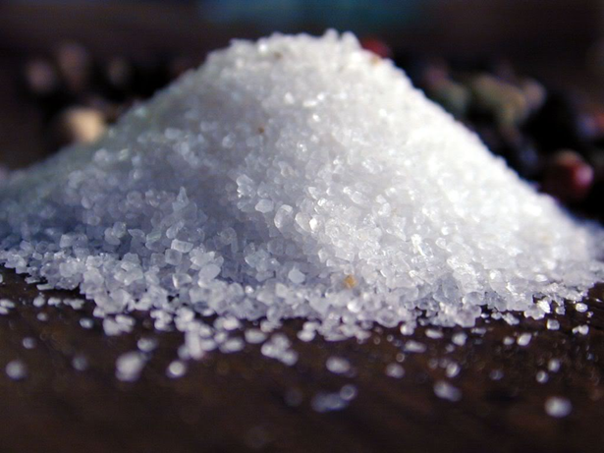
You Are Salt (Matt. 5:13)
“You are the salt of the earth; but if the salt has
become tasteless, how can it be made salty again?
It is no longer good for anything, except to be
thrown out and trampled under foot by men.
A common household item
Has Value
A Preservative
Must come into contact with the meat
Can become “unsalty”/“tasteless”/“lose its savor”
Gives Flavor
Creates Thirst

Slide 9
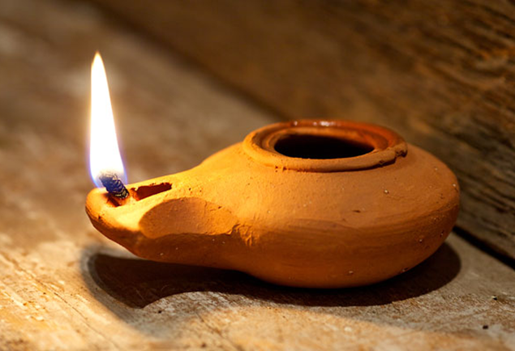
You are Light (Matt. 5:14-16)
Matt. 5:14-16 “You are the light of the world. A city set on a hill cannot be hidden; nor does anyone light a lamp and put it under a basket, but on the lampstand, and it gives light to all who are in the house. Let your light shine before men in such a way that they may see your good works, and glorify your Father who is in heaven.”

Slide 10
Light
God = Light
(1John 1:5-10; Jam. 1:17)
Jesus = Light
(John 1:4-9; John 8:12)
Satan = Darkness
(Act. 26:14-18; Col. 1:13)
We are a light
(Eph. 5:6-8; 1Thes. 5:5; John 12:35-36)
“…God is Light, and in Him there is no darkness at all. If we say that we have fellowship with Him and yet walk in the darkness, we lie and do not practice the truth; but if we walk in the Light as He Himself is in the Light, we have fellowship with one another, and the blood of Jesus His Son cleanses us from all sin…” (vss. 5-6)
“Every good thing given and every perfect gift is from above, coming down from the Father of lights, with whom there is no variation or shifting shadow.”

Slide 11
Light
God = Light
(1John 1:5-10; Jam. 1:17)
Jesus = Light
(John 1:4-9; John 8:12)
Satan = Darkness
(Act. 26:14-18; Col. 1:13)
We are a light
(Eph. 5:6-8; 1Thes. 5:5; John 12:35-36)
“In Him was life, and the life was the Light of men. The Light shines in the darkness, and the darkness did not comprehend it. There came a man sent from God, whose name was John. He came as a witness, to testify about the Light, so that all might believe through him. He was not the Light, but he came to testify about the Light. There was the true Light which, coming into the world, enlightens every man.”
“…I am the Light of the world; he who follows Me will not walk in the darkness, but will have the Light of life.”

Slide 12
Light
“…for this purpose I have appeared to you, to appoint you a minister and a witness not only to the things which you have seen, but also to the things in which I will appear to you; rescuing you from the Jewish people and from the Gentiles, to whom I am sending you, to open their eyes so that they may turn from darkness to light and from the dominion of Satan to God, that they may receive forgiveness of sins and an inheritance among those who have been sanctified by faith in Me.” (vs. 16-18)
“For He rescued us from the domain of darkness, and transferred us to the
kingdom of His beloved Son…”
God = Light
(1John 1:5-10; Jam. 1:17)
Jesus = Light
(John 1:4-9; John 8:12)
Satan = Darkness
(Act. 26:14-18; Col. 1:13)
We are a light
(Eph. 5:6-8; 1Thes. 5:5; John 12:35-36)

Slide 13
Light
God = Light
(1John 1:5-10; Jam. 1:17)
Jesus = Light
(John 1:4-9; John 8:12)
Satan = Darkness
(Act. 26:14-18; Col. 1:13)
We are a light
(Eph. 5:6-8; 1Thes. 5:5; John 12:35-36)
“Let no one deceive you with empty words, for because of these things the wrath of God comes upon the sons of disobedience. Therefore do not be partakers with them; for you were formerly darkness, but now you are Light in the Lord; walk as children of Light.” (Eph. 5:6-8)
“But you, brethren, are not in darkness, that the day would overtake you like a thief; for you are all sons of light and sons of day.” (1Thes. 5:5)

Slide 14
Light Reveals, Illuminates, & Drives Away Darkness
Eph. 5:9-14 “Do not participate in the unfruitful deeds of darkness, but instead even expose them…but all things become visible when they are exposed by the light, for everything that becomes visible is light.” (vs. 11,13)
John 3:16-21 “This is the judgment, that the Light has come into the world, and men loved the darkness rather than the Light, for their deeds were evil. For everyone who does evil hates the Light, and does not come to the Light for fear that his deeds will be exposed. But he who practices the truth comes to the Light, so that his deeds may be manifested as having been wrought in God.” (vss. 19-21)

Slide 15
Light Gives Guidance
God led the children of Israel at night as a pillar of fire (Exo. 13:21)
“Your word is a lamp to my feet and a light to my path.” (Psa. 119:105)
We follow Jesus and “walk in the light” (1John 1:7; Eph. 5:8)
“But the path of the righteous is like the light of dawn, that shines brighter and brighter until the full day.”

Slide 16
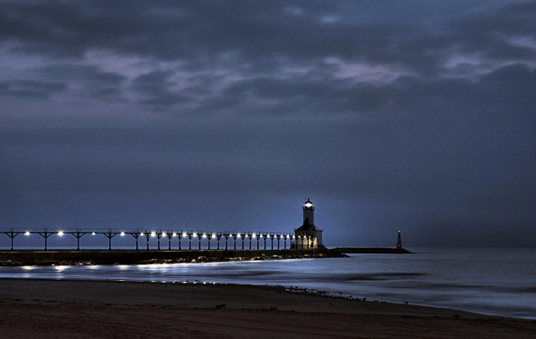
Light Gives Guidance
Brightly beams our Father’s mercy from the lighthouse ever more
But to us He gives the keeping of the lights along the shore
Dark the night of sin has settled, loud the angry billows roar
Eager eyes are watching, longing, for the lights along the shore
Trim your feeble lamp, my brother; some poor seaman tempest tossed
Trying now to make the harbor, in the darkness may be lost
Let the lower lights be burning! Send a gleam across the wave!
Some poor fainting, struggling seaman, you may rescue, you may save
- Let the Lower Lights be Burning

Slide 17
Light Warms and Comforts
Ecc. 11:7 “The light is pleasant, and it is good for the eyes to see the sun.”
Psa. 27:1 “The Lord is my light and my salvation; whom shall I fear?...”

Slide 18
Light Draws Those Out of Darkness
Acts 26:18 “to open their eyes so that they may turn from darkness to light and from the dominion of Satan to God”
John 3:20-21 “For everyone who does evil hates the Light, and does not come to the Light for fear that his deeds will be exposed. But he who practices the truth comes to the Light, so that his deeds may be manifested as having been wrought in God.”

Slide 19
Maintaining Our Influence
Phil. 2:14-16 “Do all things without grumbling or disputing; so that you will prove yourselves to be blameless and innocent, children of God above reproach in the midst of a crooked and perverse generation, among whom you appear as lights in the world, holding fast the word of life, so that in the day of Christ I will have reason to glory because I did not run in vain nor toil in vain.”
Prov. 13:20 “He who walks with wise men will be wise, but the companion of fools will suffer harm.“
Jam. 4:4 “Therefore whoever wishes to be a friend of the world makes himself an enemy of God.”

Slide 20
Questions to Consider
Salt: Who have you come into contact with? How are you maintaining your saltiness? Have you lost your savor?
Light: Who currently sees your light? Are there some whom you are hiding your light from?
What kind of influence do you have on others? How would they describe you? What can you do to maintain your good influence?

